Slide 1
LWC : Access SF Data

Slide 2
Agenda
Working with Salesforce Data
Why and How To Go Server Side From LWC?
Call Apex Method Using Wire Adapter
Call Apex Method Imperatively
Promise
Lightning Data Service :
What is LDS ?
Lightning Data Service Implementation Techniques:
Get Record
Create Record
Update Record
Delete Record
Lightning Record Forms:
Record View Form
Record Edit Form
Record Form Base Component

Slide 3


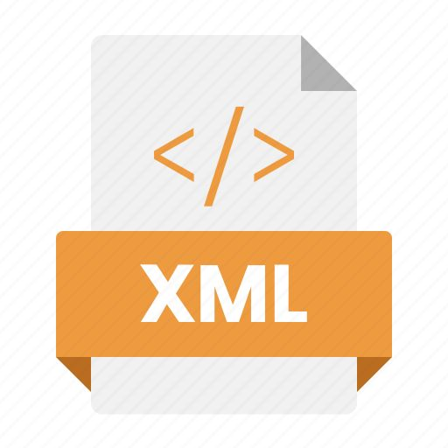




Working With Salesforce Data
LWC – Client Side
Salesforce – Server Side
APEX
HTML
APIs
JS

Slide 4
Why and How To Go Server Side From LWC?
When you use Salesforce, a lot of data is stored on the server.
While the client-side (your browser) is great for displaying data and handling user interactions,
but it doesn’t have access to Salesforce's database or business logic.
Here’s why we go to the server-side:
1. Fetching Data: When you want to display data from Salesforce, you need to ask the server to send that data to the client-side (like fetching a list of accounts or opportunities).
2. Processing Data: If you need to update, create, or delete records, that requires communicating with the server.
3. Business Logic: Sometimes you need to perform complex calculations or validations, and this logic resides on the server.
Ways of LWC's interacting with servers:
1. Apex Methods
2. APIs
3. Lightning Data Service

Slide 5
Call Apex Method Using Wire Adapter
A wire adapter is a mechanism in Lightning Web Components (LWC) that provides the retrieval of data from Salesforce's various data sources, such as Salesforce records, Apex methods, and other APIs.
Wire calls work by connecting the LWC with the server-side data source.
The adapter specifies which Apex method to call and which data to retrieve.
Whenever the LWC loads or updates, it automatically executes the wire call and retrieves the data in real time.
All the data retrieved through wire adapter, is cacheable
To make apex method accessible by LWC, the method should be annoted with @AuraEnabled
To make the apex method accessible by LWC along with enabling the caching, method should be annoted with @AuraEnabled(Cacheable=true)

Slide 6
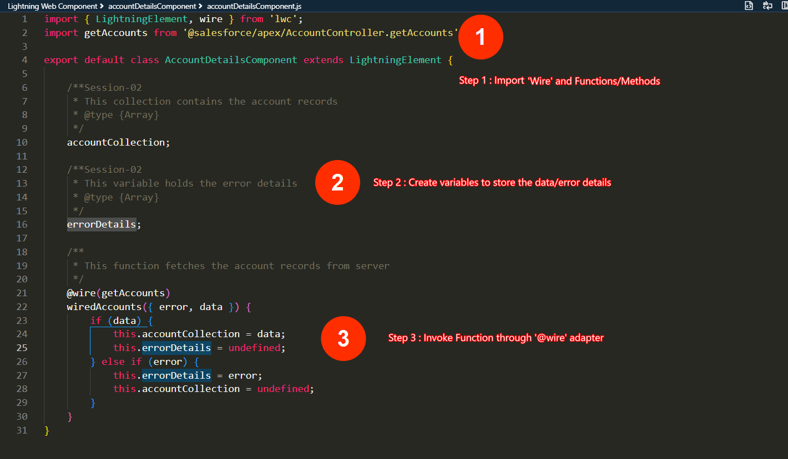
Call Apex Method Using Wire Adapter – Implementation Steps

Slide 7
Call Apex Method Imperatively
An imperative Apex call in Lightning Web Components (LWC) is triggered by actions, like when a user clicks a button or submits a form etc.
Unlike automatic data fetching, imperative calls require manual initiation, meaning the system retrieves data only when needed.
These calls are not continuously linked to the data source, meaning if there are changes on the server-side, they will not automatically update the interface. The system must request data again to reflect any updates.
Imperative calls also allow flexible data requests by sending specific inputs when needed, which can be useful when fetching data based on user preferences or specific conditions.
These calls operate asynchronously, which means the user can continue interacting with the page while the system works in the background to retrieve the necessary data, ensuring a seamless experience without interruptions.

Slide 8
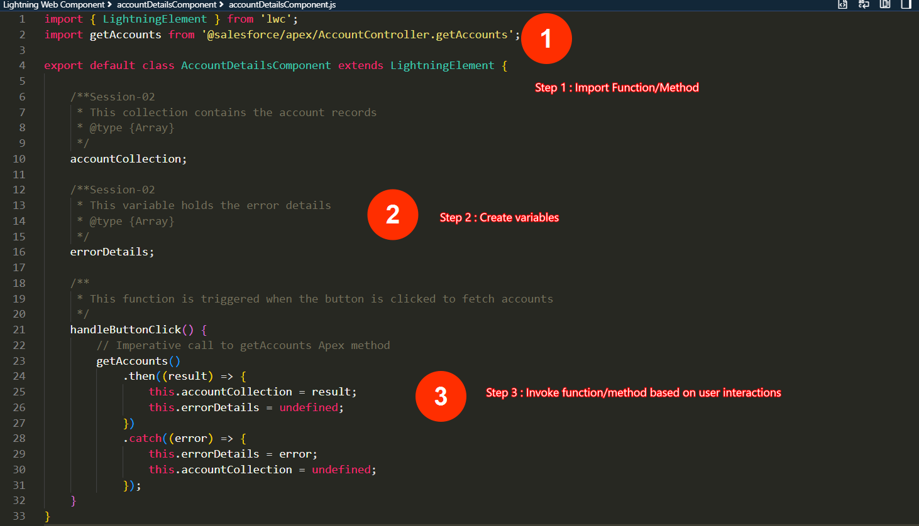
Call Apex Method Imperatively – Implementation Steps

Slide 9
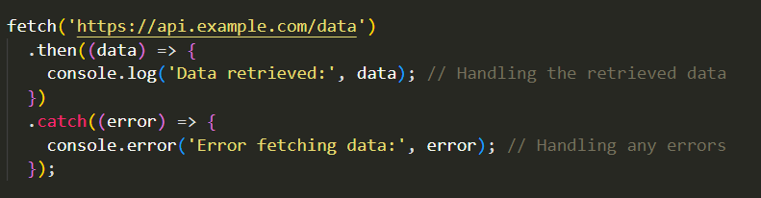
Promises
A promise represents the outcome of an asynchronous operation.
Promises can be fulfilled (success) or rejected (failure).
Three stages: 1. Pending 2. Fulfilled (success) 3. Rejected (failure).
.then(): This method is called when the promise is fulfilled (successful). It takes a callback function that handles the result of the promise.
.catch(): This method is called when the promise is rejected (failed). It takes a callback function that handles the error or failure.

Slide 10
Wire Vs Imperative
Aspects | Wire Adapter | Imperative Apex Call
Data Retrieval | Automatically retrieves and updates data | Manual trigger/call needed
Triggering Mechanism | Triggered automatically on load or re-rendered | Triggered manually by a JavaScript function, events, UI interactions
Automatic Updates | Automatically updates when server data changes. | No automatic updates; developer must re-fetch data
DML | Does not support DML | Support DML
Customization | Limited in terms of customization | Highly customizable as it allows manual data fetching and processing.
Use Case | Ideal when you need automatic data fetching, real-time updates. | Best suited for scenarios where you need full control over when to fetch data, such as on-demand actions triggered by user interactions like button clicks.

Slide 11
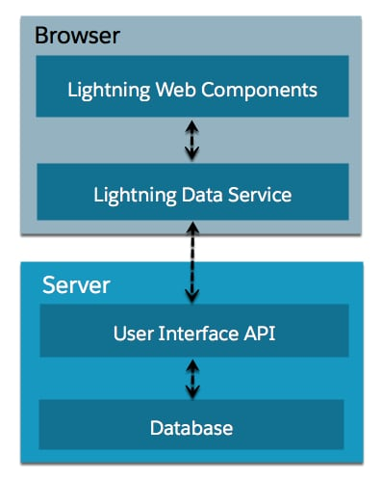
Salesforce – Lightning Data Service (LDS)
Lightning Data Service (LDS) is a powerful and efficient mechanism in Salesforce that allows Lightning Web Components (LWC) to interact with Salesforce data without the need to write Apex
Lightning Data Service is built on top of User Interface API. UI API is a public Salesforce API that Salesforce uses to build Lightning Experience and Salesforce for iOS and Android.
LDS respects Salesforce's security and sharing model. It automatically enforces field-level security, object-level permissions, and sharing rules, ensuring that users only see the data they have access to.
LDS uses a shared cache mechanism. When a component requests data, LDS first checks its cache. If the data is present and up-to-date, it’s served directly from the cache, making the process lightning-fast. If not, LDS fetches the data from the server, updates its cache, and then serves it to the component.

Slide 12
Salesforce – Lightning Data Service (LDS)
Advantages of LDS | Disadvantages of LDS
Enhanced Performance - LDS uses a client-side cache to store Salesforce data. This means when a component requests data, LDS can often fetch it from this cache, eliminating the need for a server round trip and ensuring faster data retrieval. | No Bulk Operations - LDS is designed to work with single records, which means if you need to operate on multiple records simultaneously, you’ll have to look beyond LDS.
Real-time Data Consistency - LDS automatically refreshes the UI of components when underlying data changes, ensuring users always see the most recent data without manual refreshes. | Platform Restrictions - LDS is not available for Visualforce pages or any other platforms outside of Lightning Experience
No Need for Apex - With LDS, developers can perform CRUD operations directly from the front end without writing any Apex code | Cache Limitations - While the caching mechanism of LDS improves performance, there’s a risk of components displaying stale or outdated data if the cache isn’t updated in real time.
Enhanced Data Security - LDS respects Salesforce’s built-in data security mechanisms, including field-level security, sharing rules, and CRUD permissions. | Limited Error Handling - LDS often provides generic error messages, which might not be descriptive enough for developers to pinpoint issues or for users to understand the problem.
Cost Efficiency - By serving data from its cache and minimizing server interactions, LDS can help reduce the number of API calls, potentially leading to cost savings for the organization. | Dependency on Salesforce’s Infrastructure - If there are performance issues or outages in Salesforce’s infrastructure, LDS might experience delays or disruptions, affecting the user experience.

Slide 13
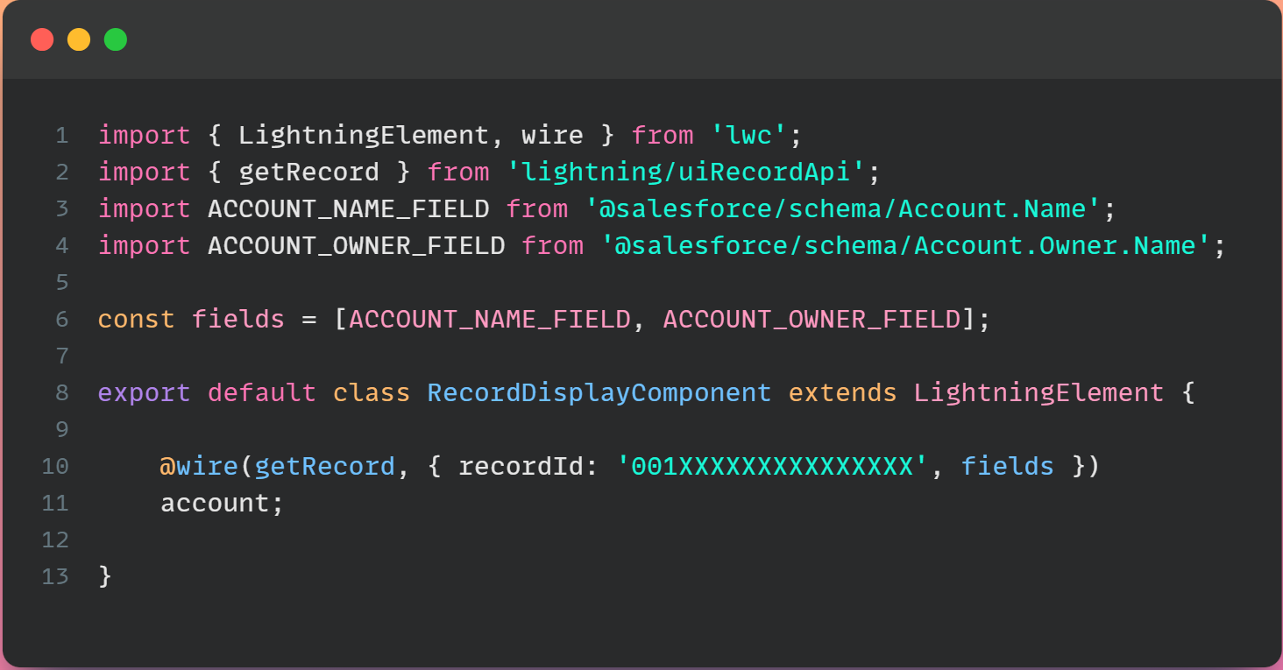
Lightning Data Service Implementation Techniques – Get Records
Load Records:
The getRecord wire adapter is specifically designed for fetching records.

Slide 14
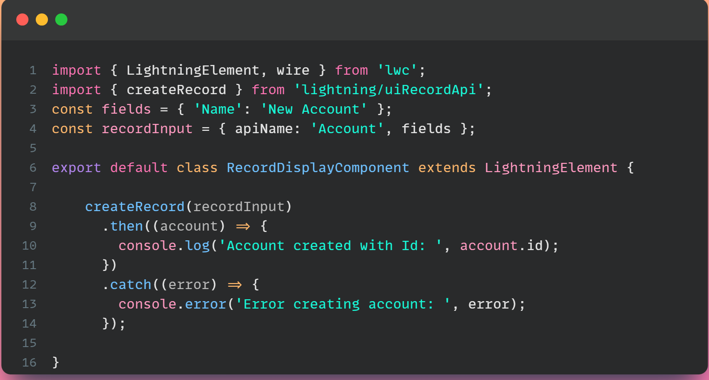
Lightning Data Service Implementation Techniques - Create
2. Create Records:
The createRecord wire adapter is specifically designed for creating records without apex

Slide 15
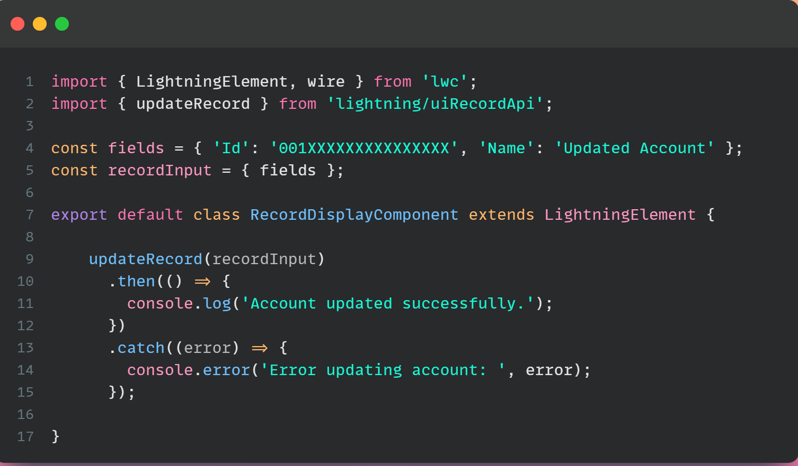
Lightning Data Service Implementation Techniques - Update
3. Update Records:
The updateRecord wire adapter is specifically designed for updating records without apex

Slide 16
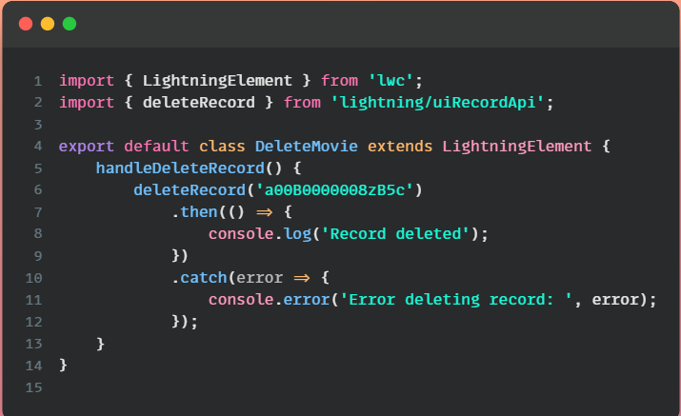
Lightning Data Service Implementation Techniques - Delete
4. Delete Records:
The deleteRecord wire adapter is specifically designed for deleting thr records without apex

Slide 17
Lightning Data Service Implementation Techniques
There are three components that are built on Lightning Data Service(LDS)
1. Lightning Record View Form:
This form will allow you to view the record and to customize fields in the form.
2. Lightning Record Edit Form:
This form will allow you to create and edit the record and to customize fields in the form.
3. Lightning Record Form:
This form allow us to display a form with standard Lightning UI to view, edit, or create a record.

Slide 18
Lightning Record View Form
The lightning-record-view-form component to create a form that displays Salesforce record data for specified fields associated with that record.
The fields are rendered with their labels and current values as read-only.
lightning-record-view-form requires a record ID to display the fields on the record.
This component also takes care of field-level security and sharing for you.
Users will see data only if they have access to view specific field and record.

Slide 19
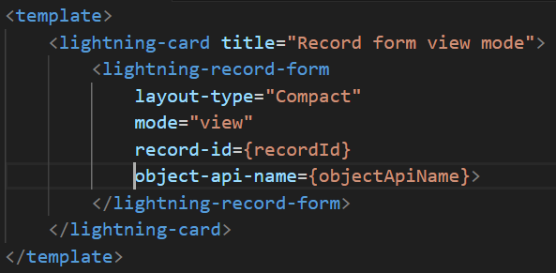
Lightning Record View Form
RecordFormViewMode.html

Slide 20
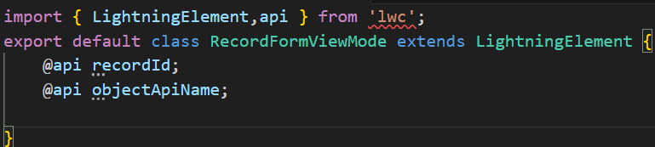
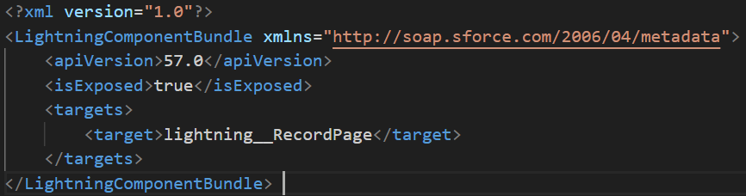
Lightning Record View Form
recordFormViewMode.js
recordFormViewMode.xml

Slide 21
Lightning Record Edit Form
The lightning-record-edit-form component to create a form that's used to add a Salesforce record or update fields in an existing record on an object.
Editing a record's specified fields, given the record ID.
Creating a record using specified fields.
Customizing the form layout
Custom rendering of record data

Slide 22
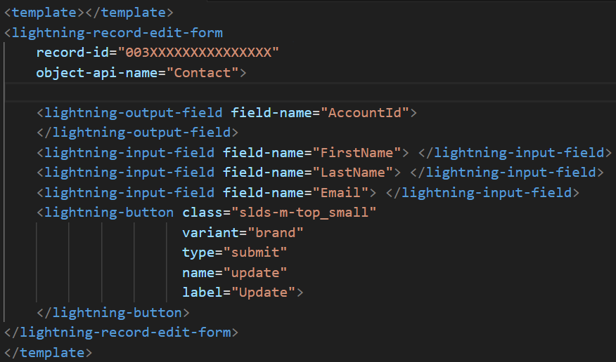
Lightning Record Edit Form
recordFormEditMode.html

Slide 23
Lightning Record Edit Form
recordFormEditMode.js
recordFormEditMode.xml

Slide 24
Lightning Record Form
The lightning-record-form component to quickly create forms to add, view, or update a record.
Switches between view and edit modes automatically when the user begins editing a field in a view form
Provides Cancel and Save buttons automatically in edit forms
Uses the object's default record layout with support for multiple columns
Loads all fields in the object's compact or full layout, or only the fields you specify

Slide 25
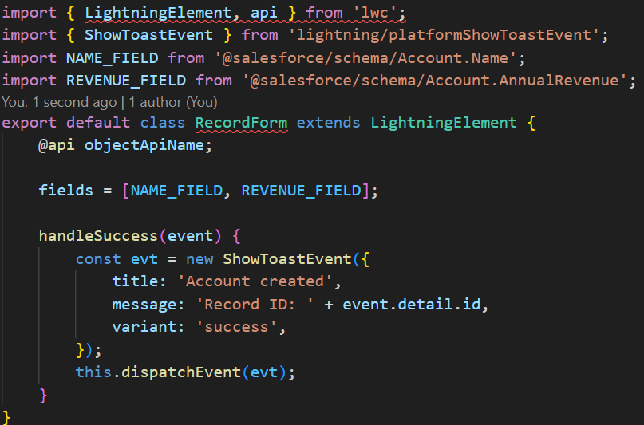
Lightning Record Form
recordForm.html

Slide 26
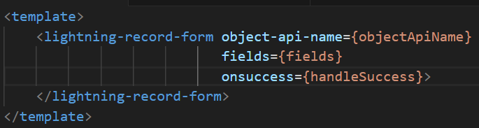
Lightning Record Form
recordForm.js
recordForm.xml

Slide 27
Thank You
Any Questions ?

